Slide 1
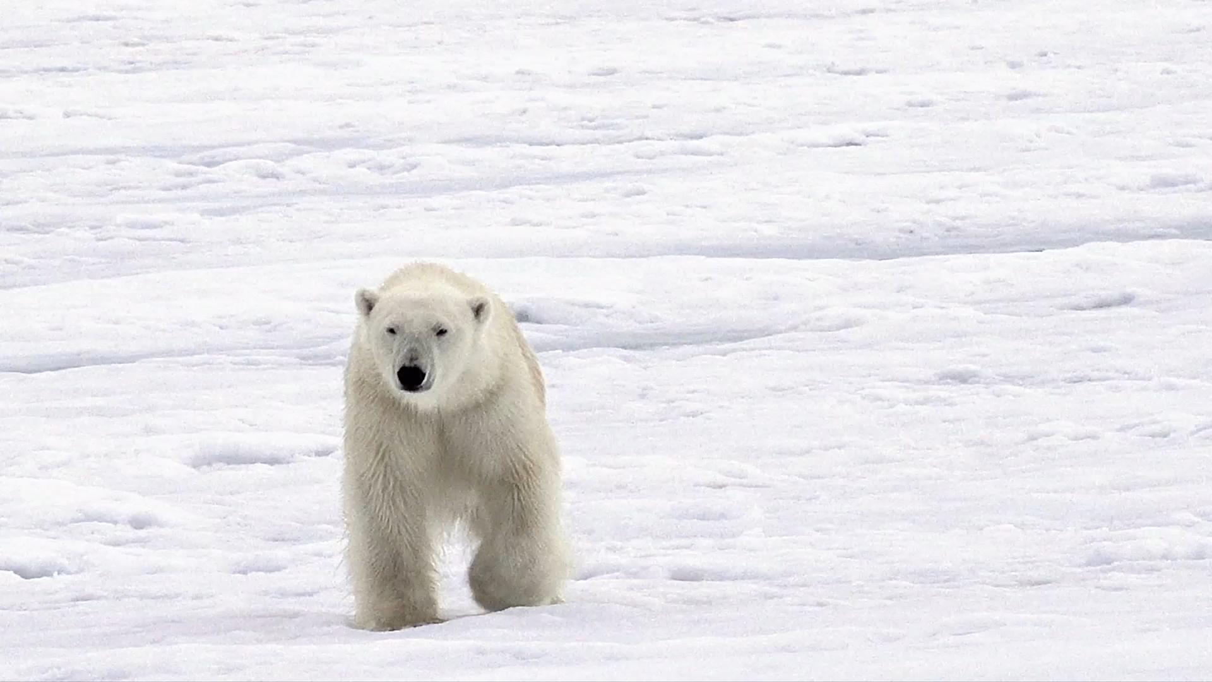
Intro to Polars
Center for Data and Visualization Sciences
Joel Herndon joel.herndon@duke.edu
September 9, 2025
Notes:
Welcome! This presentation will last about an hour or so. I’ll linger for questions. My backgound in Polars/Python. Please ask questions during presentation. We’ll have 3 sections.

Slide 2
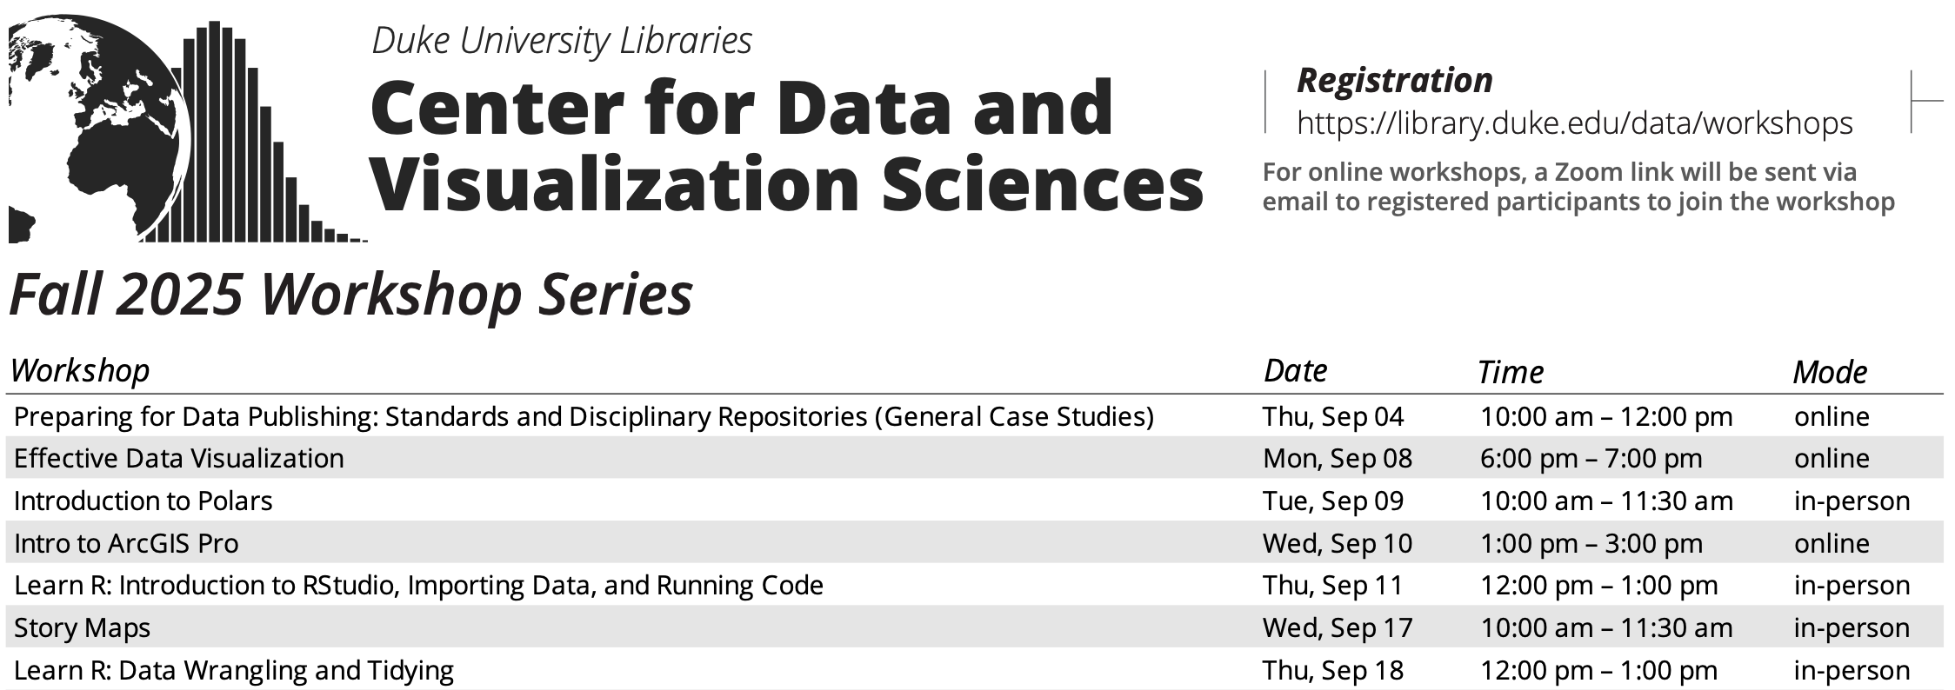
library.duke.edu/data/workshops

Slide 3
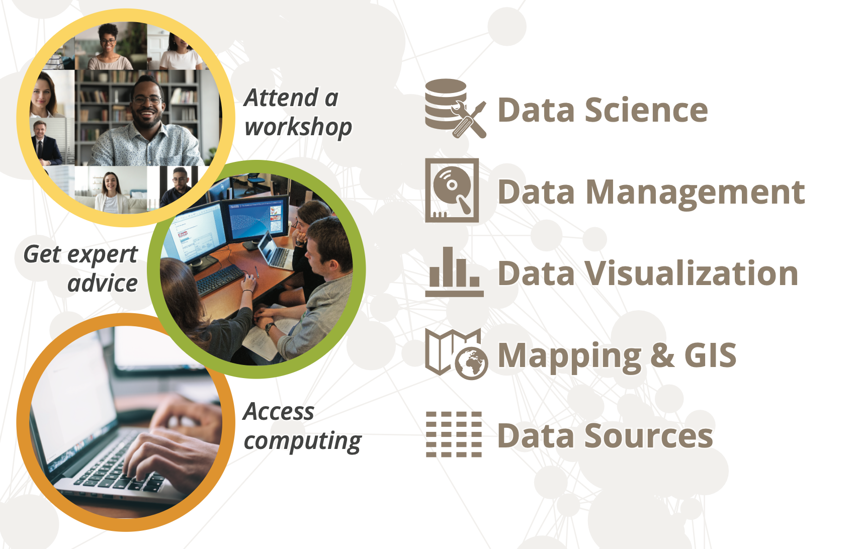
askdata@duke.edu

Slide 4
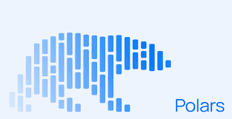
Intro to Polars: Workshop Materials
Workshop materials: https://duke.is/polars-fall-25
Google Colab: colab.research.google.com
Get help: askdata@duke.edu

Slide 5
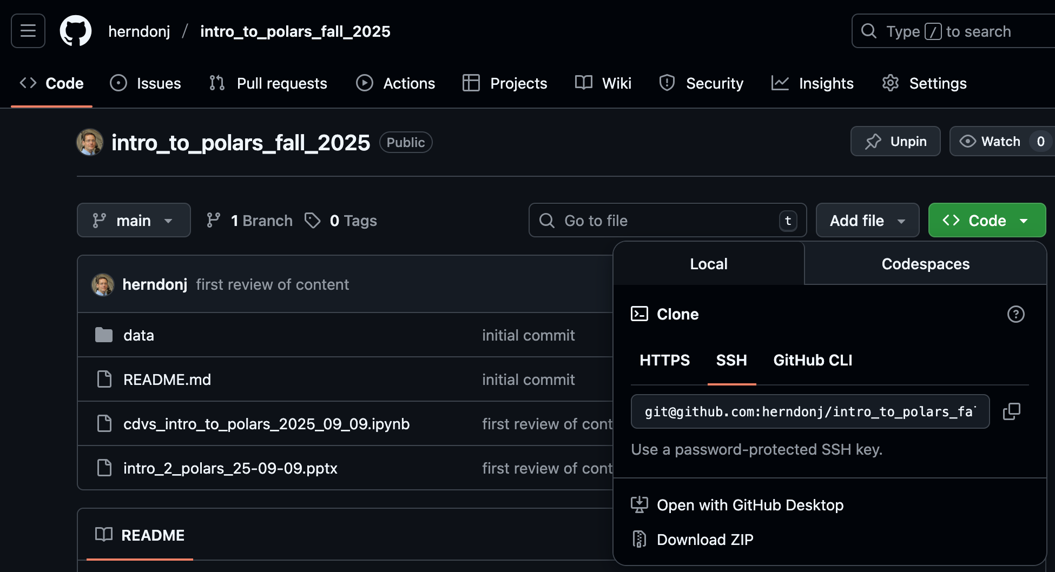
1. Click here
2. Then, click here…

Slide 6
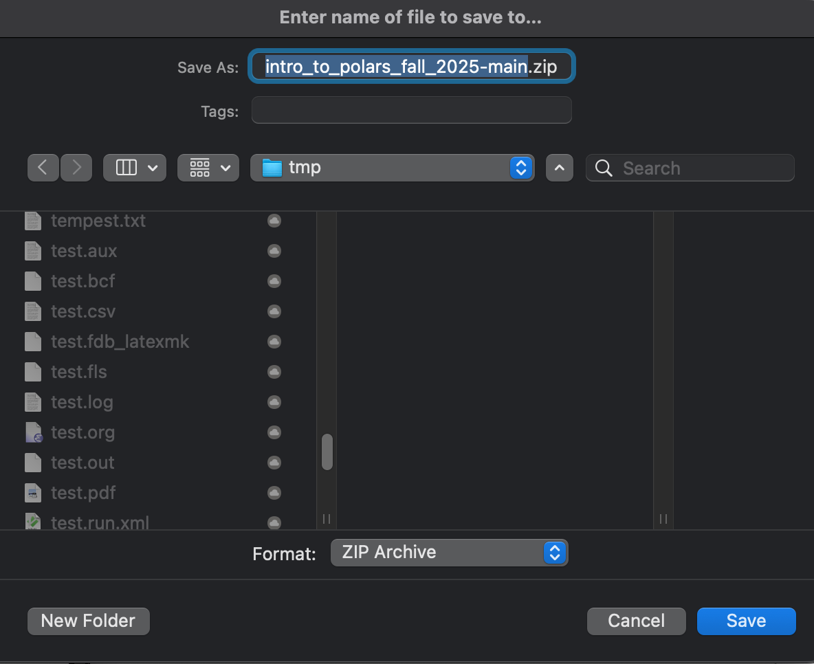
3. Keep track of the where you save and uncompress the file!

Slide 7
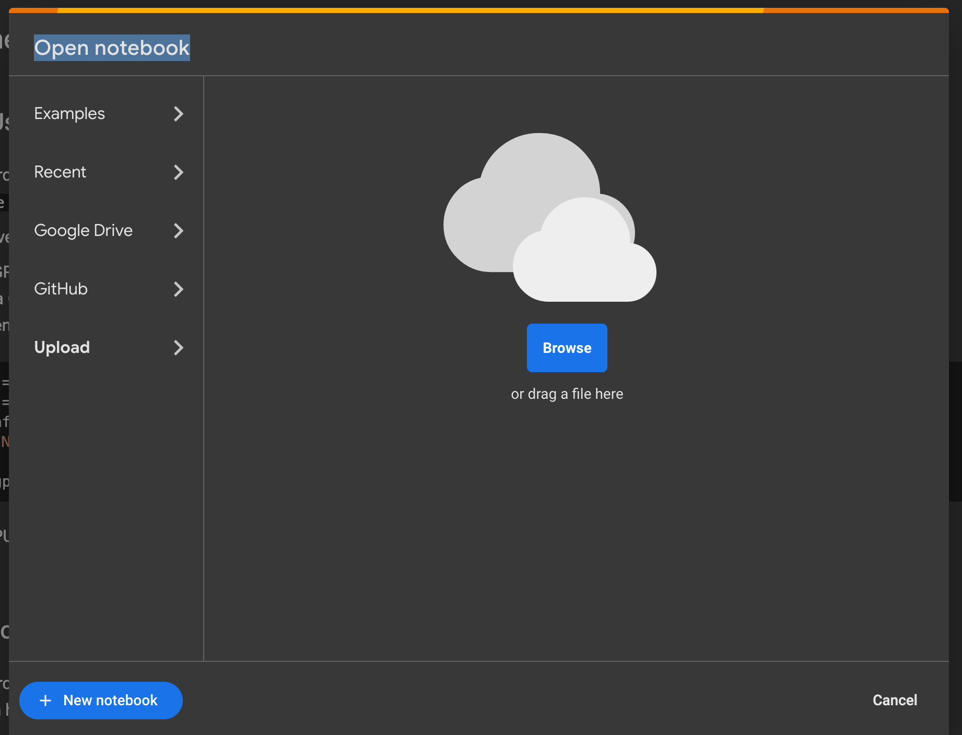
colab.research.google.com
2. Then, click here…
1. Click here

Slide 8
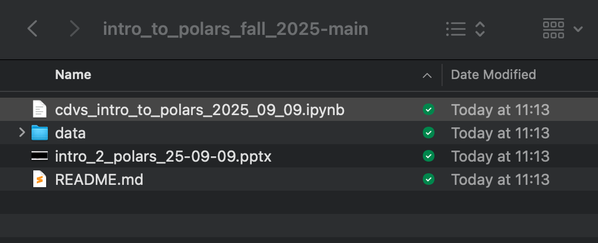
3. Select “cdvs_intro… .ipynb” (see below)

Slide 9
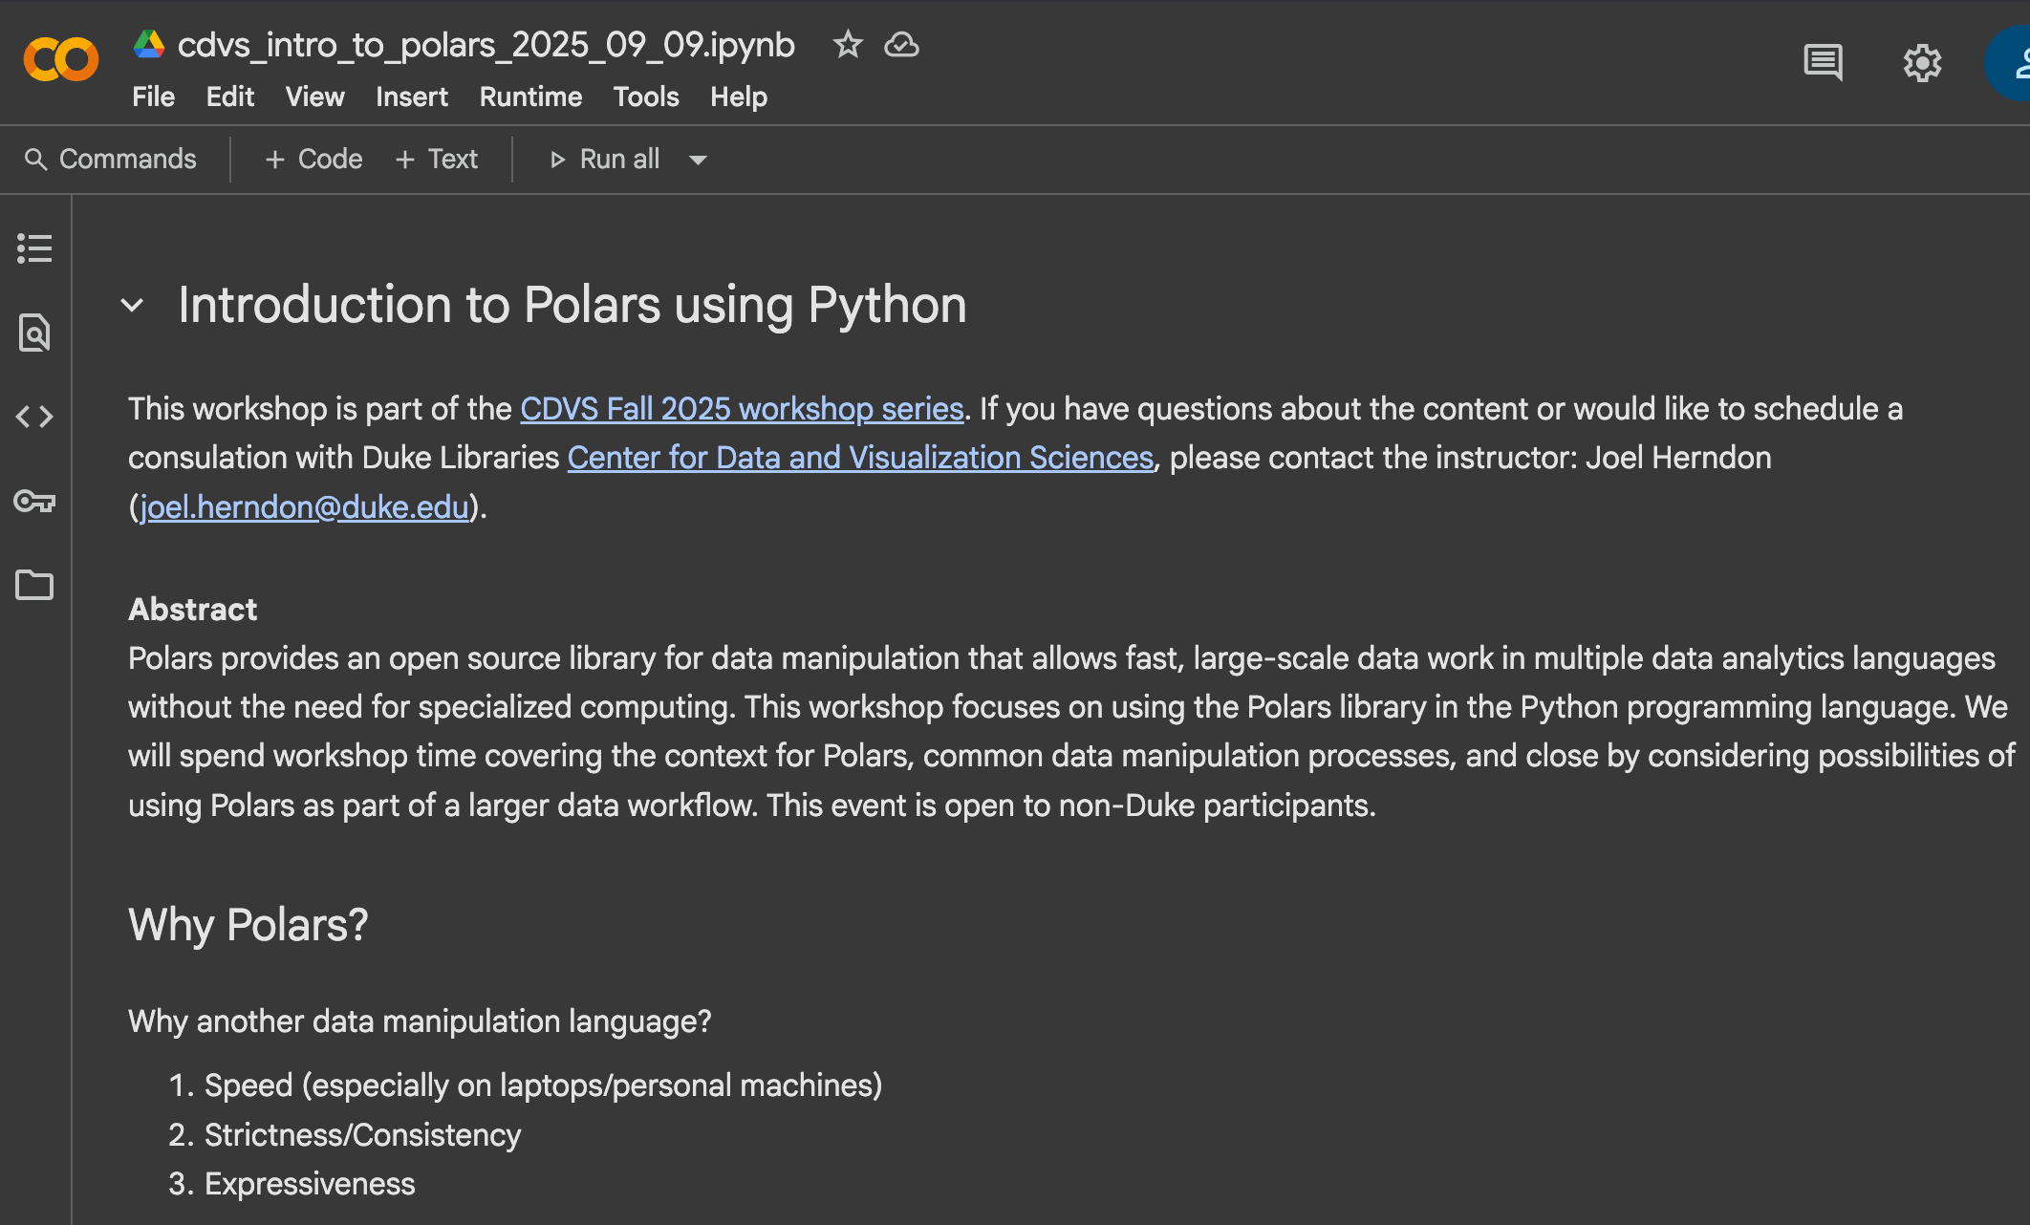
Success!

Slide 10
Workshop Rules and goals
Accept questions throughout presentation
Demonstrate “enough Polars” to assess its usefulness
Provide clear examples that suggest Polars capabilities.
Reduce friction by using a cloud environment (but allow other IDEs)
Accept constructive feedback

Slide 11
Why Polars?
Speed
Strictness (or consistency)
Expressiveness
“Come for the speed, stay for the API” – Janssens and Nieuwdorp, 2025

